Slide 1
Global Management Accounting Principles overview and opportunity for research

Slide 2
Agenda
CGMA (AICPA – CIMA)
Global Management Accounting Principles
Success factors
Discussion
Research opportunities

Slide 3
CGMA
(AICPA – CIMA)
CGMA, Chartered Global Management Accountant
AICPA, American Institute of Certified Public Accountants
CIMA, Chartered Institute of Management Accountants
The AICPA and CIMA have joined together to form a joint venture
which powers a new designation for management accountants,
the Chartered Global Management Accountant (CGMA).
The CGMA is designed to elevate management accounting
and furhter emphasise its importance for business

Slide 4
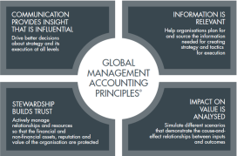
Global Management Accounting Principles
1/13
CGMA (CIMA) definition of Management accounting:
  “Management accounting is the sourcing, analysis, communication and use of decision-relevant financial and non-financial information to generate and preserve value for organizations”.
As a profession, management accounting requires a thorough understanding of the business (including the business model) and its operating environment so that organizational risks and opportunities are known. By managing and responding appropriately to risks, organizations can exploit opportunities and generate value for stakeholders over time.

Slide 5
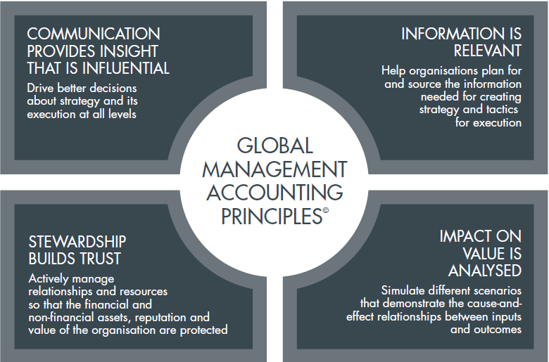
Global Management Accounting Principles
2/13

Slide 6
COMMUNICATION PROVIDES INSIGHT
THAT IS INFLUENTIAL
Global Management Accounting Principles
3/13
Objective – To drive better decisions about strategy and its execution at all levels
Strategy development and execution is a conversation
Communication is tailored
Communication facilitates better decisions

Slide 7
INFORMATION IS RELEVANT
Global Management Accounting Principles
4/13
Objective – To help organisations plan for and source the information needed for creating strategy and tactics for execution
Information is the best available
Information is reliable and accessible
Information is contextual

Slide 8
IMPACT ON VALUE IS ANALYSED
Global Management Accounting Principles
5/13
Objective – To simulate different scenarios that demonstrate the cause-and-effect relationships between inputs and outcomes
Simulations provide insights into options
Actions are prioritized by their impact on outcomes

Slide 9
STEWARDSHIP BUILDS TRUST
Global Management Accounting Principles
6/13
Objective – To actively manage relationships and resources so that the financial and non-financial assets, reputation and value of the organisation are protected
Accountability and credibility
Sustainability
Integrity and ethics

Slide 10
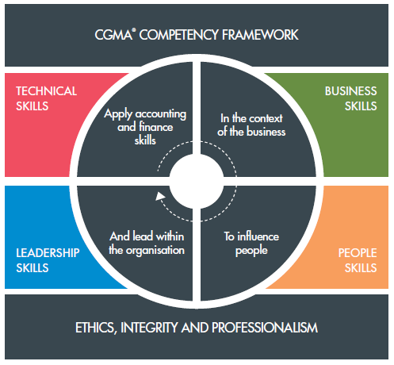
Global Management Accounting Principles
7/13
An effective management accounting function is made up of skilled and competent people, who apply the Principles to maintain and improve an organization’s performance management system
through the areas of practice they undertake.
People
(the capabilities
of trusted finance
Professionals)

Slide 11
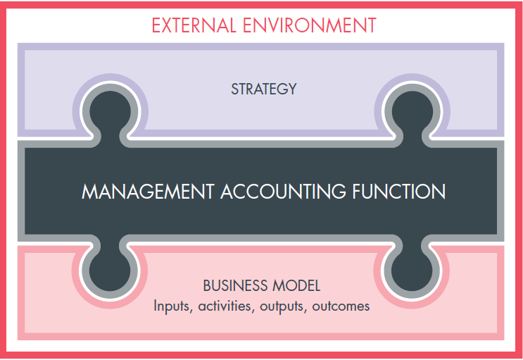
Global Management Accounting Principles
8/13
An effective management accounting function is made up of skilled and competent people, who apply the Principles to maintain and improve an organization’s performance management system
through the areas of practice they undertake.
Performance

Slide 12
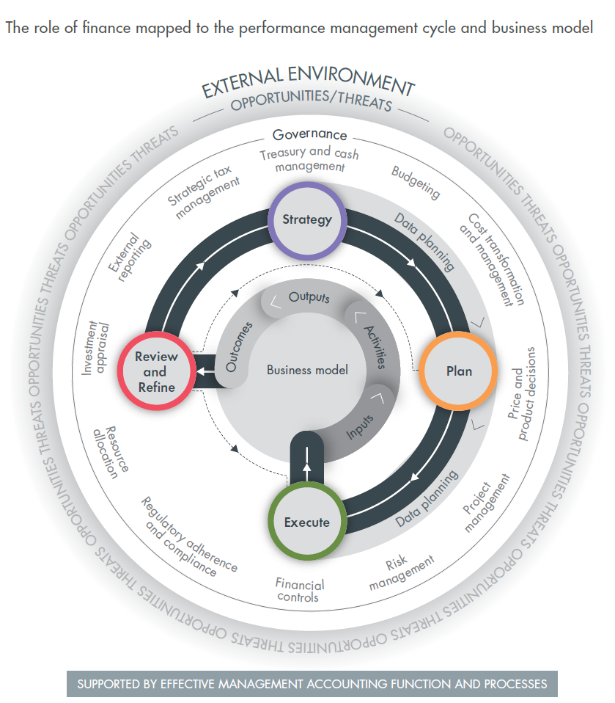
Global Management Accounting Principles
9/13
An effective management accounting function is made up of skilled and competent people, who apply the Principles to maintain and improve an organization’s performance management system
through the areas of practice they undertake.
Practices

Slide 13
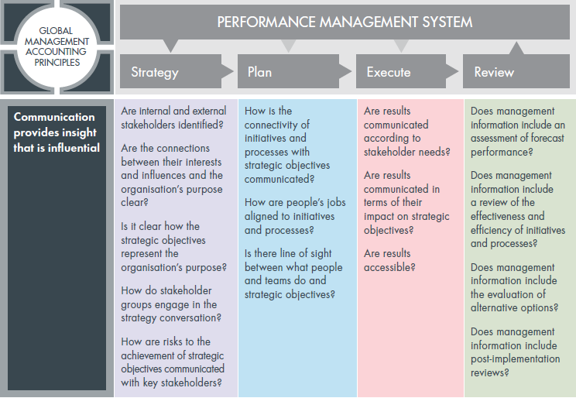
Global Management Accounting Principles
Application to Performance Management System
10/13

Slide 14
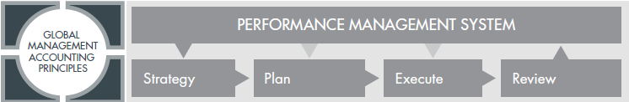
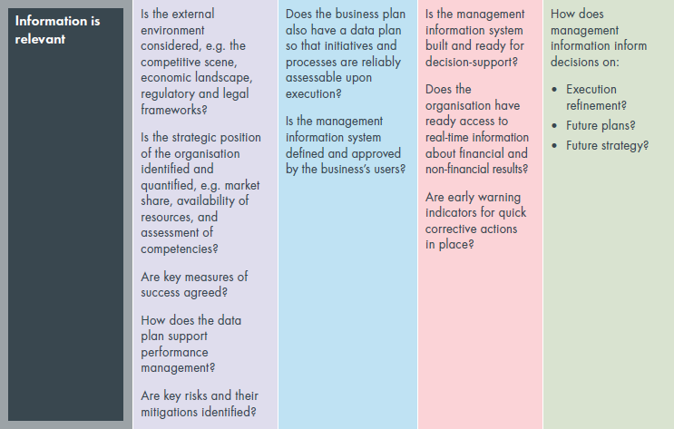
Global Management Accounting Principles
11/13

Slide 15
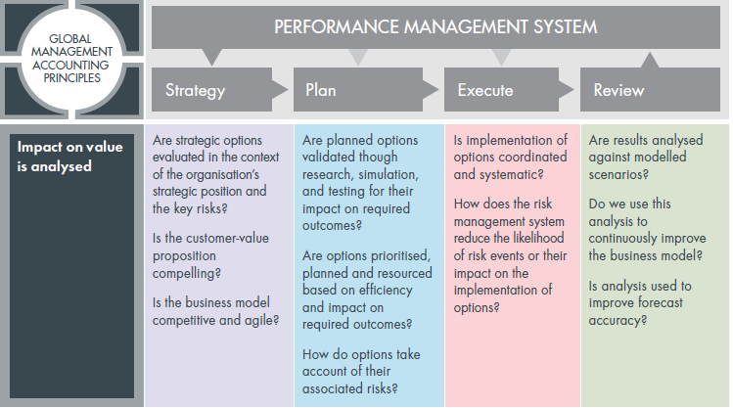
Global Management Accounting Principles
12/13

Slide 16
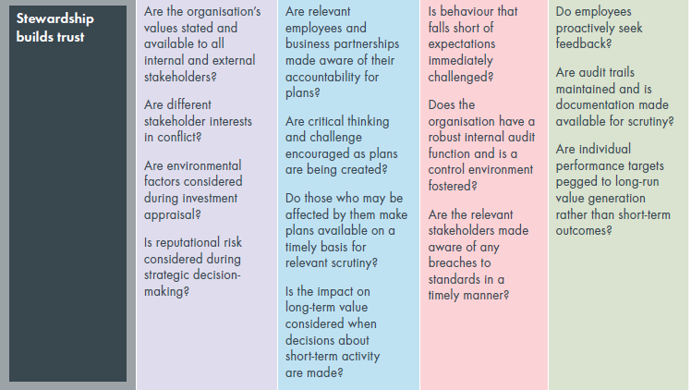
Global Management Accounting Principles
13/13

Slide 17
Success factors
Three factors enhance the effective application of the principles:
Understanding the need – the appreciation that management accounting can help organisations achieve sustainable success.
Tools and techniques – in the practical application of the Principles, people need to use appropriate tools and techniques.
Diagnostic – people skills, Principles, practice areas and performance management systems can help organisations assess the effectiveness of their management accounting functions and identify areas for improvement.

Slide 18
Discussion
Are principles the solution to the management accounting issues?
Do principles provide effective guidance to management accountants?
Are all the examined practices part of management accounting?
Could management accounting standards work better?

Slide 19
Research opportunities
Linking the key principles, concepts and elements
underpinning the GMAP to the management accounting theories
Investigating the connection between
the GMAP and the business model towards integrated reporting

